Slide 1

Area and Wirelength Optimization in VLSI Floorplanning
Using Stockmeyer, HPWL and Simulated Annealing Techniques
BEVD303L - CAD FOR IC DESIGN
23BVD1006 M Ramya Sree
23BVD1030 R Sandhyaa,
23BVD1044 Tejasvini R,
23BVD1061 Jagarakshitha V

Slide 2


Project Objective
The main goal is to minimize the total chip cost by optimizing two key metrics:
•
Chip Area: Reducing the physical silicon footprint to lower manufacturing costs.
•
Wirelength (HPWL): Minimizing interconnect lengths to reduce signal delay, power consumption, and improve performance.
Our approach implements and compares a hybrid flow of algorithms to achieve a globally optimal and physically constrained floorplan.

Slide 3






Core Algorithms
Stockmeyer Algorithm
HPWL Model
Simulated Annealing
Half-Perimeter Wirelength. A fast, efficient model to estimate the total interconnect wirelength cost.
A stochastic optimization method to find a global minimum by exploring the solution space and escaping local minima.
A dynamic programming algorithm to find the minimal area for a slicing floorplan from a given Polish expression.

Slide 4

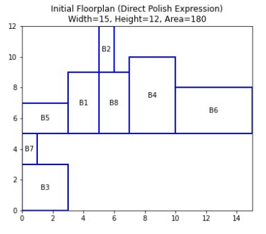
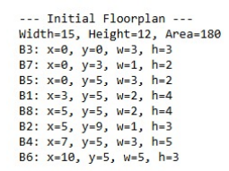
Step 1: Initial Floorplan (Before)
Based on the initial Polish expression: B3 B7 H B5 B1 V B8 B2 H V B4 V B6 V H
This direct translation results in a non-optimal layout with significant wasted space.

Slide 5
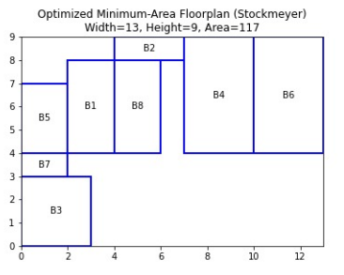
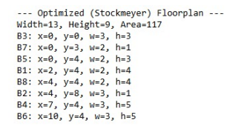
Step 2: Stockmeyer Optimization (After)
The Stockmeyer algorithm is applied to find the optimal area configuration for the same slicing structure.
It intelligently rearranges blocks to minimize dead space and create a compact layout.
Inputs:
Set of Blocks
Possible Block Shapes
Polish Expression

Slide 6
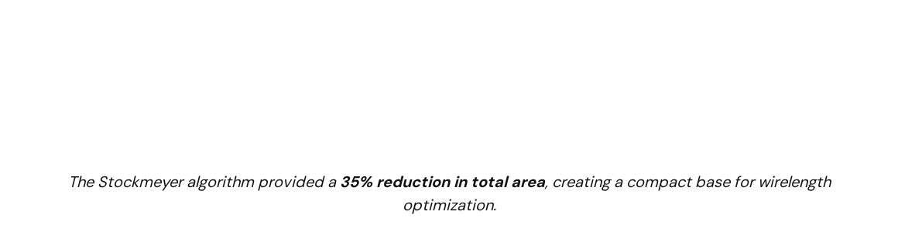
Results: Area Optimization
Floorplan Stage | Width (W) | Height (H) | Area (A = W × H)
Initial Floorplan | 15 | 12 | 180
Stockmeyer Optimized | 13 | 9 | 117

Slide 7
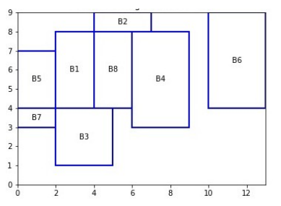

Wirelength Optimization
Applying HPWL and Simulated Annealing (SA) to the Stockmeyer floorplan to reduce interconnect costs.
Inputs:
Block Dimensions
Netlist
Net1: B1, B3
Net2: B2, B4
Net3: B1, B2, B5
Net4: B3, B4, B5
Net5: B1, B4
FLOORPLAN OF HPWL MODEL (LOCAL MINIMA)

Slide 8
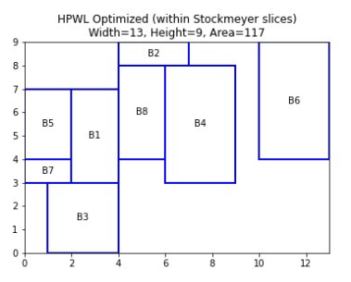
SIMULATED ANNEALING
Both the model is modified to enforce the Stockmeyer-generated boundary (W=13, H=9) as a fixed constraint.
This prevents the floorplan from expanding or contracting, ensuring a dimensionally consistent layout.
This result balances area compactness with wirelength reduction.
Final Stats:
•
HPWL LOCAL MINIMA :
•
HPWL GLOBAL MINIMA (SIMULATED ANNEALING):
FLOORPLAN AFTER SIMULATED ANNEALING

Slide 9
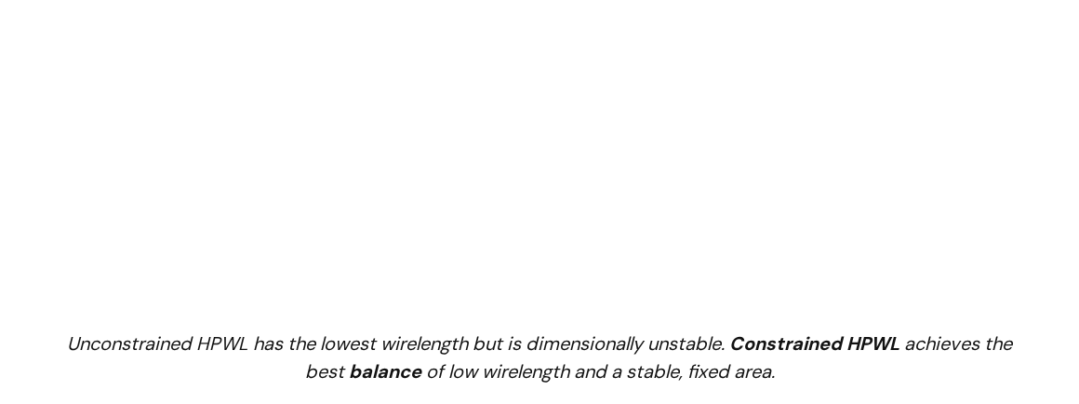
Results: Wirelength Comparison
Optimization Stage | Wirelength (HPWL) | Total Cost (Area + HPWL)
Stockmeyer Floorplan | 37.00 | 154.00
HPWL + Stockmeyer(constrained) | 31.00 | 148.00
SA + Stockmeyer(constrained) | 33.50 | 150.50

Slide 10
Conclusion
Area Optimized: The Stockmeyer algorithm provides an excellent, area-efficient (35% reduction) starting point for the floorplan.
Problem Identified: Unconstrained HPWL and SA methods achieve low wirelength but are impractical as they violate physical design boundaries.
Optimal Solution: The Constrained HPWL model is the superior solution. It maintains the compact area from Stockmeyer while achieving significant wirelength reduction.
Final Takeaway: This hybrid pipeline ensures a dimensionally stable, area-efficient, and wirelength-optimized floorplan, which is critical for practical VLSI implementation.

